Slide 1
The Elephants
Mo, Lasse & Vlady (Mentor))

Slide 2
Group The Elephants
Started out 5 finished 2
Tech background limited
Learned a lot
The Habit App

Slide 3
The Habit App
The start
Goal project CRUD
Choose Tech stack, React, CSS & Node.js
Features, tracking & local storage
Wireframes, Habit pick, Timeframe, create, update & delete habit

Slide 4
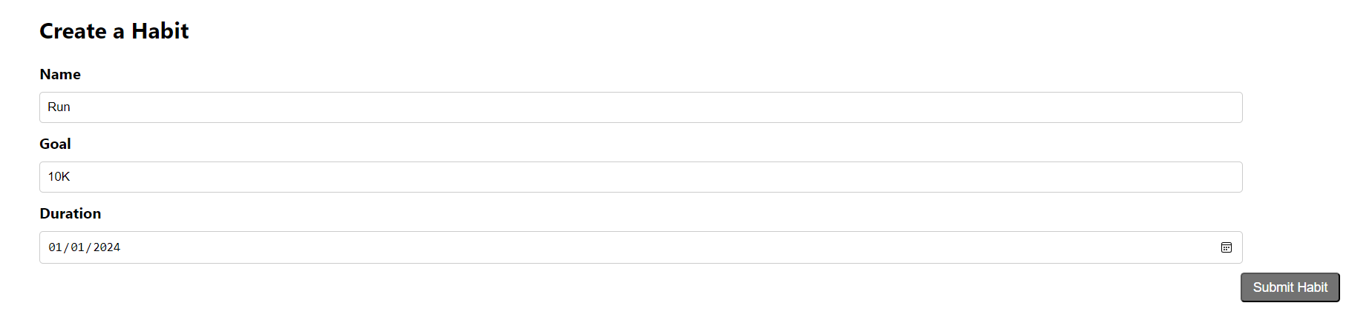
Create a Habit

Slide 5
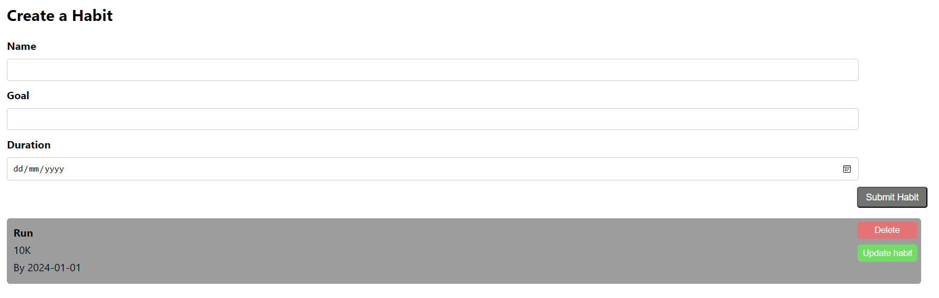
Habit appears in list

Slide 6
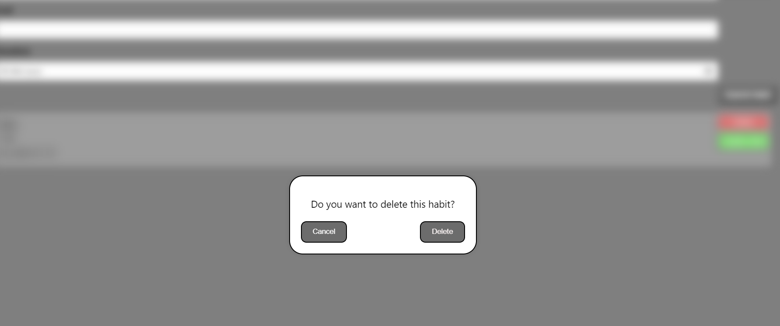
Delete habit

Slide 7
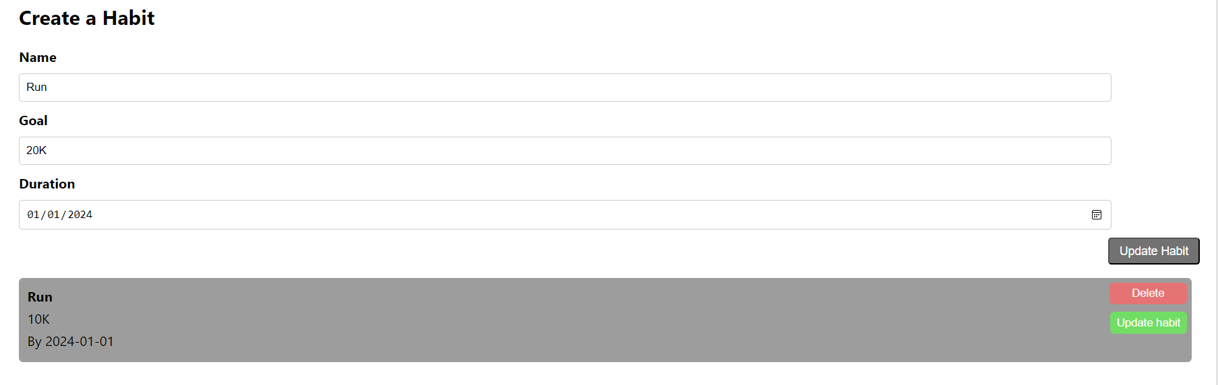
Update habit

Slide 8
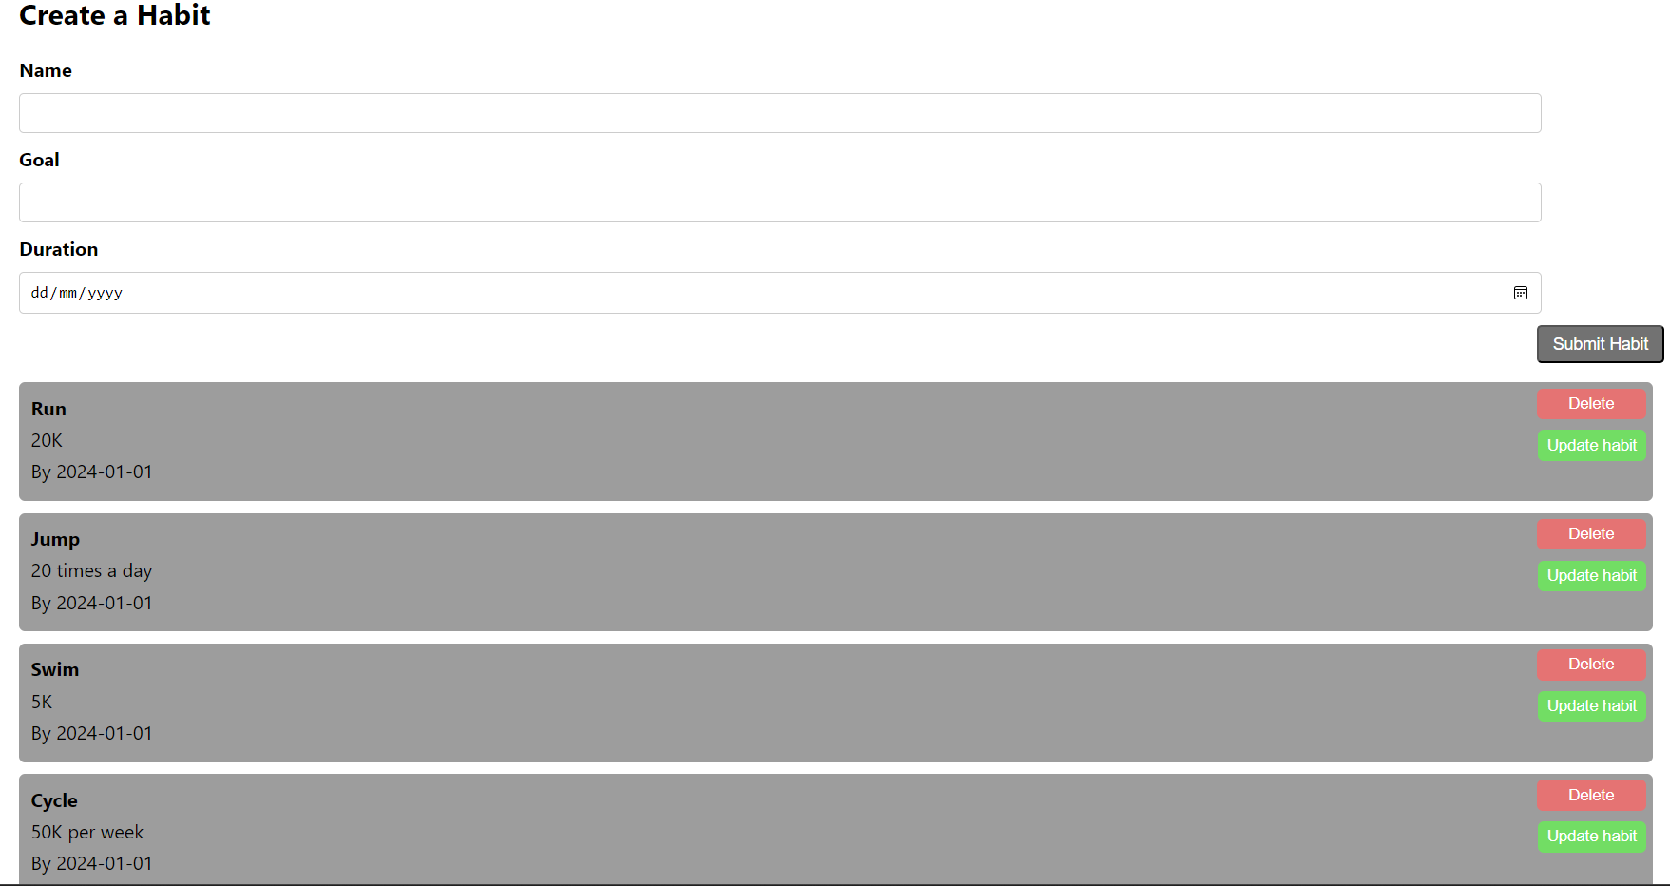
Overview of habits

Slide 9
Thank you for listening & Techlabs for a great course

